Slide 1
L11.01 Dynamic Programming II
50.004 Introduction to Algorithm
Dr. Simon LUI
ISTD, SUTD

Slide 2
Objective
Rod cutting example
Text justification example

Slide 3
How do we use dynamic programming to solve some problem P?
Break-down P using divide-and-conquer into sub-problems (SPs)
By writing the solution of P in terms of the solutions of sub-problems of P
Recurse and memoize OR build SP table bottom up
Complexity: we assume that due to memoization, each sub-problem is solved only once
Notes:
operations: on how many sub-problems it depends

Slide 4
Alternative way to think about it
How do we use dynamic programming to solve some problem P?
Break-down P using divide-and-conquer into sub-problems
Define potential sub-problems
Guess: a possible solution in terms of solutions of sub-problems
Optimization: optimize over all possible guesses, k= # of guesses
Recurse and memoize OR build table bottom up
Complexity: # of potential sub-problems that need to be solved x k guesses/sub-problem (due to memoization each sub-problem is solved only once; each guess takes Θ(1) time)

Slide 5
Example – rod cutting

Slide 6

Rod cutting problem
A rod of size n
A table of prices p_{i} = price in the market of a rod of size i = 1,2,…,n
Determine the maximum revenue DP[n] obtained by cutting the rode into pieces and selling these to the market
Do we need to consider all possible combinations? No! use DP!
Notes:
If place where I make the cuts matter: I consider all possible cut positions
If the quality of the wood is not uniform, then we might have to consider all combinations.
A simple way when we do recursion is to consider all combinations and assign values.
If place of cuts don’t matter we can reuse solutions, and use DP (momoization)

Slide 7
Example
size of piece | 1 | 2 | 3 | 4
market price | 2 | 5 | 7 | 8
Rod of size n=4
Write down the DP equations (recurrence)
Which are my sub-problems?
How are these related?

Slide 8
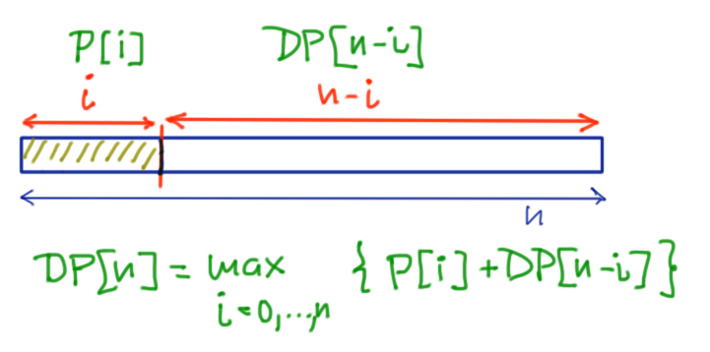
Example
size of piece | 1 | 2 | 3 | 4
market price | 2 | 5 | 7 | 8
Rod of size n=4
Write down the DP equations (recurrence)
Which are my sub-problems?
How are these related?
a guess

Slide 9
Example
size of piece | 1 | 2 | 3 | 4
market price | 2 | 5 | 7 | 8
Rod of size n=4
Write down the DP equations (recurrence)
Which are my sub-problems?
How are these related?
0

Slide 10
Example
size of piece | 1 | 2 | 3 | 4
market price | 2 | 5 | 7 | 8
Rod of size n=4
Write down the DP equations (recurrence)
Which are my sub-problems?
How are these related?
+2
0
2

Slide 11
Example
size of piece | 1 | 2 | 3 | 4
market price | 2 | 5 | 7 | 8
Rod of size n=4
Write down the DP equations (recurrence)
Which are my sub-problems?
How are these related?
+5
+2
0
2
5

Slide 12
Example
size of piece | 1 | 2 | 3 | 4
market price | 2 | 5 | 7 | 8
Rod of size n=4
Write down the DP equations (recurrence)
Which are my sub-problems?
How are these related?
+7
+5
+2
0
2
5
7

Slide 13
Example
size of piece | 1 | 2 | 3 | 4
market price | 2 | 5 | 7 | 8
Rod of size n=4
Write down the DP equations (recurrence)
Which are my sub-problems?
How are these related?
+8
+2
+7
+5
0
2
5
7
10

Slide 14
General DP formulation:
a guess
j possible guesses

Slide 15
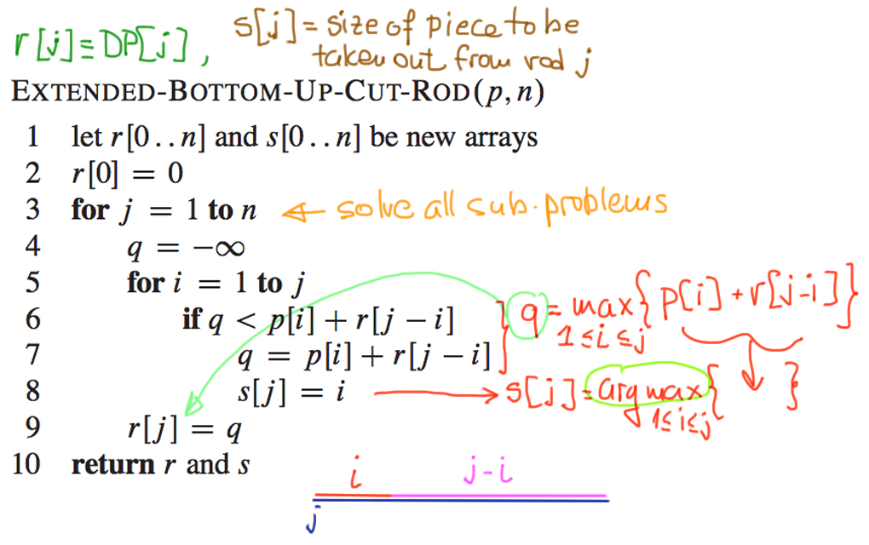
Notes:
argmax

Slide 16
Lets fill the table (bottom-up solution of DP)
Topological sort:
compute DP[j] from left to right
0
1
…
j-i
j-2
j-1
j
0 1 2 3 4 5 6 7 8 9 10
0
0
Exercise1: fill in the table with the solutions DP[j], j=0,…,10,
of the sub-problems, and the optimal decisions s[j] for each j
Exercise2: the complexity is a: n, b: n^2, c: n^3

Slide 17
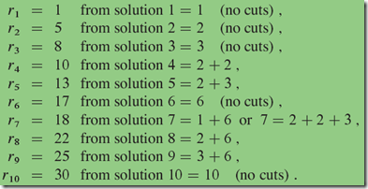
Answer
len | 0 | 1 | 2 | 3 | 4 | 5 | 6 | 7 | 8 | 9 | 10
DP[] | 0 | 1 | 5 | 8 | 10 | 13 | 17 | 18 | 22 | 25 | 30
S[] | 0 | 0 | 0 | 0 | 2 | 2 | 0 | 1 | 2 | 3 | 0

Slide 18
Example – text justification

Slide 19
The text justification problem
Split text into “good” lines so that a set of consecutive lines looks “nice”
bad!
blah blah blah
blah
averylongword
0b
blah blah
blah blah
averylongword
4b
good!
8b
4b
0b
0b
Question 1: Which algorithm is used in the “bad case”?
breaks randomly the text into lines that fit the given page length
works “myopically”: fills each line to the maximum possible without caring for the next lines
Notes:
Guess the algorithm for the bad case
Cost function: I never like to use more lines than necessary, distribute evenly the blank spaces / line

Slide 20
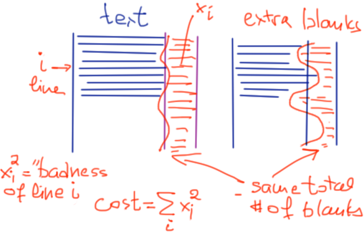
The text justification problem
Split text into “good” lines so that a set of consecutive lines looks “nice”
bad!
blah blah blah
blah
averylongword
0b
blah blah
blah blah
averylongword
4b
good!
8b
4b
0b
0b
Question 2: Guess a good mathematical criterion for assessing “badness” of a solution
total # of blank spaces,
worse case of extra blank spaces in some line,
Notes:
Guess the algorithm for the bad case
Cost function: I never like to use more lines than necessary, distribute evenly the blank spaces / line

Slide 21
Why use the cost ?
Consider the problem of allocating K extra blank spaces to m lines.
If we use the” badness” function
then solving
gets us that at the optimum. Hence this cost function is reduced not only when the total number of extra blank spaces is reduces, but also when our extra blanks are distributed more evenly among the lines. This property holds when the square is replaced by any value a>1.

Slide 22
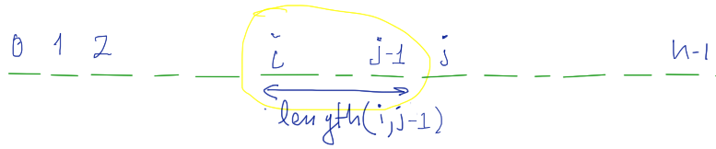
We are given a sequence of n words (different lengths)
length(i,j)=total useful space needed for words i,…,j-1
Goal: split words into lines to minimize
Which are the DP equations?
Notes:
Discuss more details on function length
Which are the DP equations?

Slide 23
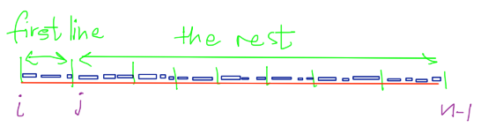
DP[i]: minimum possible cost for words[i..n-1 ]
sub-problem = suffix of [0..n-1], # of sub-problems = Θ(n)
Guessing: j = where to end first line, # of choices = n-i
Recurrence:
cost(i,j-1)
?
DP(j)
this is known already.
someone should have calculated all badness() and save in a table
Notes:
j cannot be too big…
Which is the time per sub-problem?

Slide 24
Recurrence:
Order of computation: n, n-1, …, 1, 0 (topological sort)
Total time = Θ(n²)
Solution = DP[0]
Notes:
Connection with rod cutting!

Slide 25
What you need to learn from this example
The mindset in constructing the DP sub-problem

